Slide 1
Combo Circuit Lab by Trish Loeblein phet.colorado.edu
Learning Goals: Students will be able to:
Analyze the differences between real circuits and the ideal ones,
Build circuits from schematic drawings,
Use a multimeter to take readings in circuits.
Provide reasoning to explain the measurements in circuits.

Slide 2
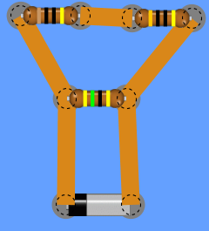
12. What is the total resistance in this circuit?
6.4 Ω
21 Ω
38 Ω
75 Ω
Notes:
B [1/(30+40) + 1/45]^-1 =21

Slide 3
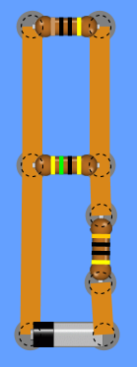
13. What is the total resistance in this circuit?
6.4 Ω
21 Ω
38 Ω
75 Ω
Notes:
C. [1/(45+10) ]^-1 + 30=38

